Slide 1
Analysing Effect of tags on movie ratings
Akanchha Choudhary

Slide 2
This is a mini project for week 6 of course python for data science from micromaster of Ucsandiego in data science. We were given this practice project to prepare us for next two big project in this course. I am supposed to perform following steps for this mini project that has been mentioned below:
Step 1: Select a dataset we’ve already seen
Step 2: Continue to explore the dataset(s)
Step 3: Identify one research question
Step 4: Use appropriate methods to explore your data.
Step 5: Present your findings
Step 6: Present your work!

Slide 3
Dataset(s)
As a first step of this project. I am asked to choose a one of three dataset that has already been discussed in this course.I am choosing Movielens dataset which is a IMBD dataset and make analysis of movies domain.
The dataset is available for download here - https://grouplens.org/datasets/movielens/20m/
Description about the dataset, as shown on the website is below:
This dataset (ml-20m) describes 5-star rating and free-text tagging activity from MovieLens, a movie recommendation service. It contains 20000263 ratings and 465564 tag applications across 27278 movies. These data were created by 138493 users between January 09, 1995 and March 31, 2015. This dataset was generated on October 17, 2016.
Users were selected at random for inclusion. All selected users had rated at least 20 movies. No demographic information is included. Each user is represented by an id, and no other information is provided.
The data are contained in six files, genome-scores.csv, genome-tags.csv, links.csv, movies.csv, ratings.csv and tags.csv. More details about the contents and use of all these files follows.

Slide 4
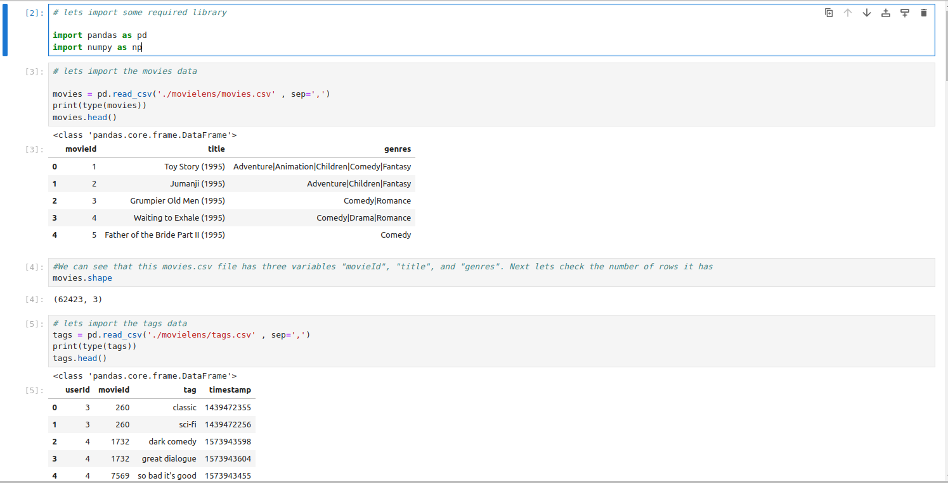
Lets perform some analysis . I have loaded movies.csv, ratings.csv and tags.csv and did some initial analysis with command shown below.

Slide 5
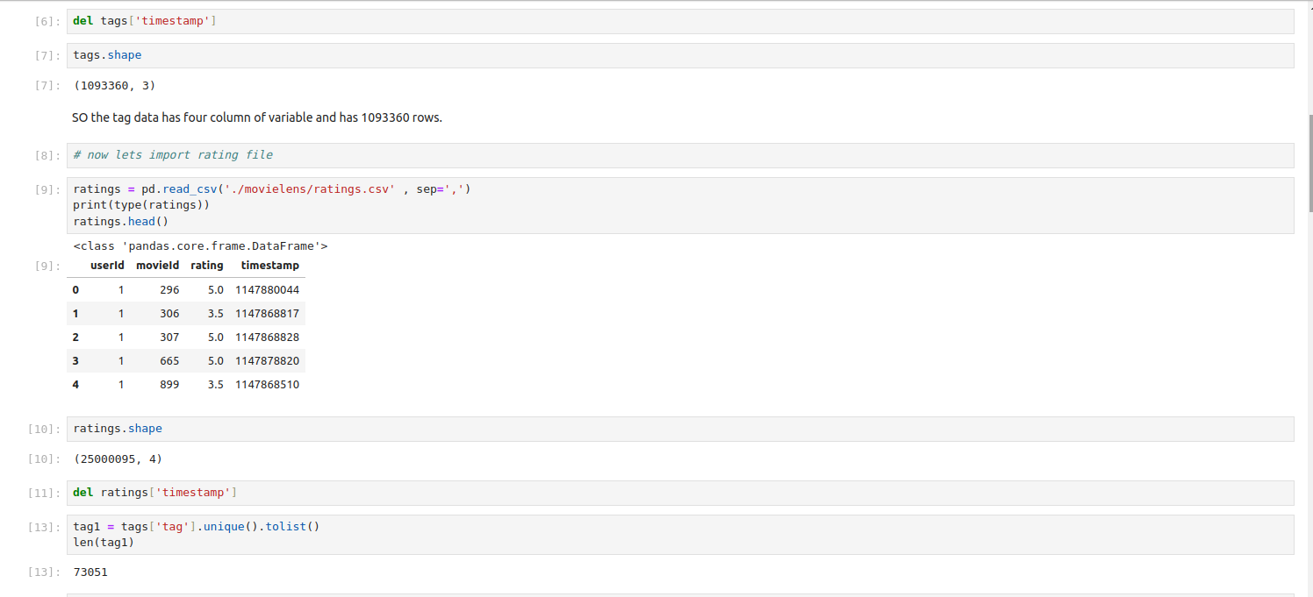
Lets perform some analysis . I have loaded movies.csv, ratings.csv and tags.csv and did some initial analysis with command shown below.

Slide 6
Research Question
Based on the above exploratory commands, I believe that the following questions can be answered using the dataset for example
1.highly rated movie by year
2.Is there any correlation between rating and frequency of tagging.
3. Most watch genres of all time.
For the analysis I will go with 3rd research question

Slide 7
Performing more analysis using pandas and matplotlib to answer the research question

Slide 8
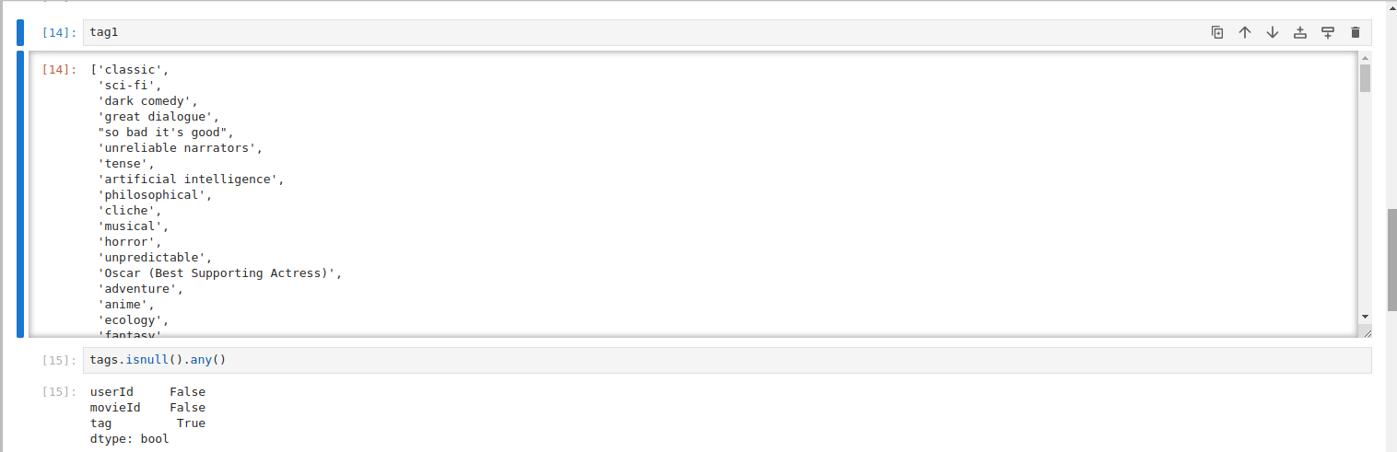
Performing more analysis using pandas and matplotlib to answer the research question

Slide 9
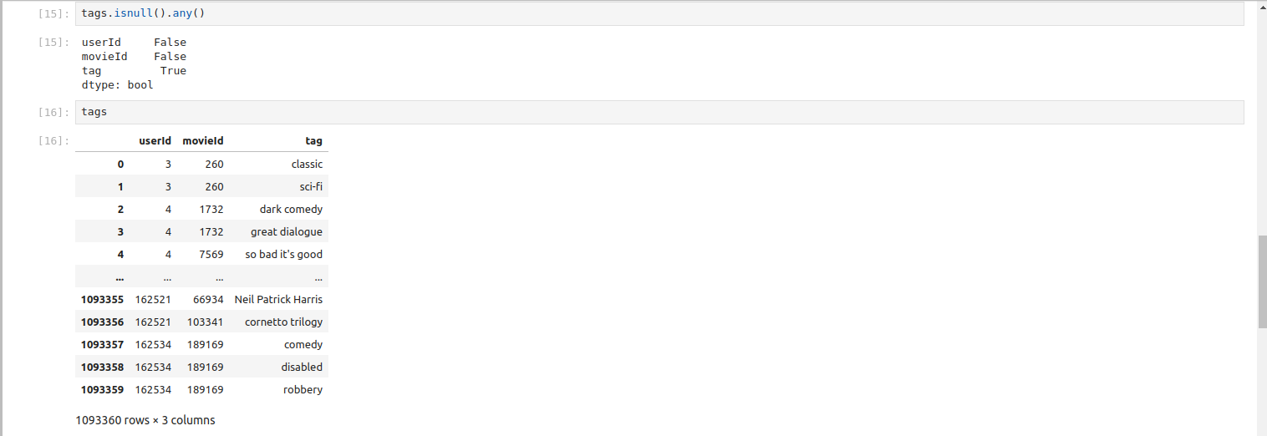
Performing more analysis using pandas and matplotlib to answer the research question

Slide 10
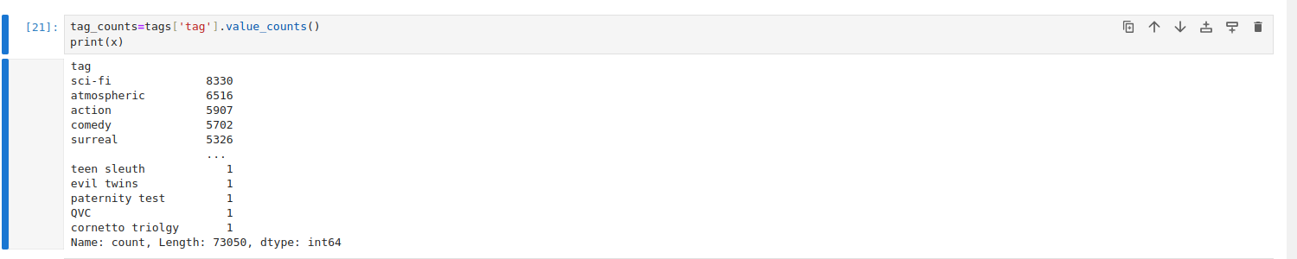
Performing more analysis using pandas and matplotlib to answer the research question

Slide 11
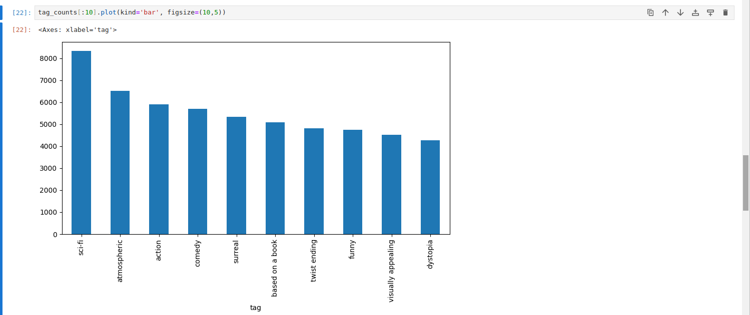
Performing more analysis using pandas and matplotlib to answer the research question

Slide 12
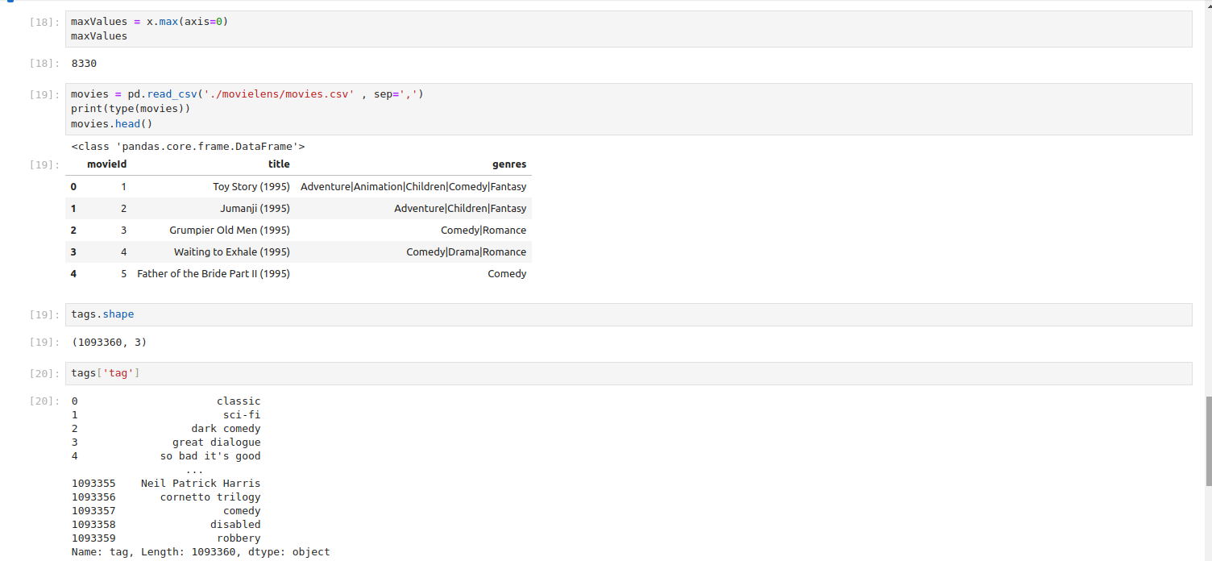
Performing more analysis using pandas and matplotlib to answer the research question

Slide 13
Reporting findings/analyses
As per the analysis and as shown in graph the most watch genres is SCIFI with 8330 counts.

